Slide 1

A Project Presentation on
AirSwipe: An AI-Driven Presentation
Controller With Gesture and Voice
Recognition
Under The Guidance of
Mrs. Pradnya K. Bachhav
Presented by
Miss Ayesha Shaikh
Miss Pooja Gupta
Miss Shiba Shaikh
Miss Anushka Jadhav
BE (Computer Engineering)
Department of Computer Engineering
AY: 2024-25
Guru Gobind Singh College of Engineering and Research Centre,
Nashik
1

Slide 2
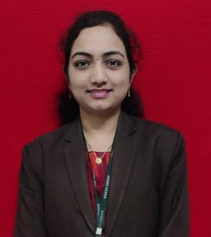
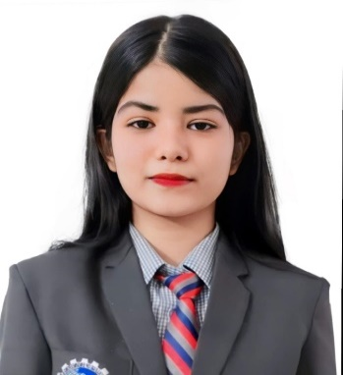
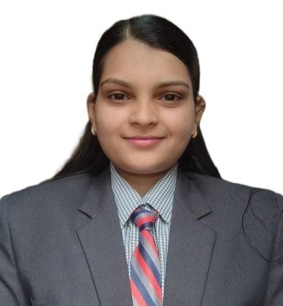
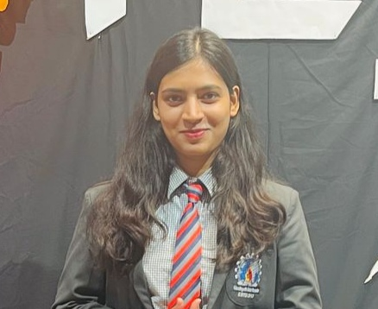
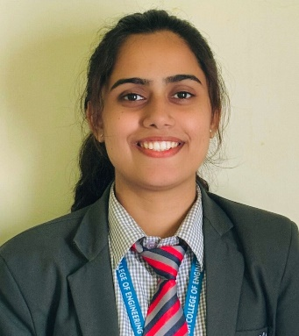
Our Team
Mrs. Pradnya K. Bachhav
Ayesha G. Shaikh
Shiba A. Shaikh
Pooja G. Gupta
Anushka B. Jadhav
11th June 2025
2

Slide 3
Presentation Outline
Abstract
Introduction
Literature Survey
Conclusion from Literature Survey
Objectives
System Architecture
Algorithms used
Test Cases
Results
Deployment
Conclusion
References
Paper Publication/Conference/Competition details with certificates
11th June 2025
3

Slide 4
Abstract
The proposed idea AI Presentation Tool Using Gesture Recognition introduces an innovative AI-driven presentation tool that utilizes hand gestures for controlling PowerPoint slides, aiming to transform the presentation experience. By enabling presenters to interact with their slides through natural movements, the tool eliminates the reliance on traditional physical devices, such as remotes or keyboards, fostering a more fluid and engaging atmosphere. The system employs advanced computer vision and deep learning techniques to accurately recognize hand gestures in real-time, providing a hands-free solution that is particularly beneficial for users with physical disabilities. The proposed tool not only simplifies the act of presenting but also enhances accessibility, making it an ideal fit for diverse environments, including classrooms, corporate meetings, conferences, and virtual settings.
11th June 2025
4

Slide 5
Introduction
Traditional presentation tools (clickers, keyboards) interrupt natural flow and reduce audience engagement.
These tools also pose accessibility challenges for individuals with disabilities.
The proposed solution: an AI-powered presentation tool using gesture recognition and voice control for hands-free slide control.
Enhances focus, interactivity, and inclusivity in presentations.
Features an intuitive interface for smooth navigation and dynamic interaction.
Benefits professionals, educators, and differently-abled users alike.
11th June 2025
5

Slide 6
Literature Survey
Name of paper | Authors | Date Of Publication | Working | Merits | Demerits
Automated Digital Presentation Control using Hand Gesture Technique | Salonee Powar, Shweta Kadam, Sonali Malage, Priyanka Shingane | 2022 | 1. Detects hand gestures in real-time using AI via webcam. 2. No gloves or markers required uses OpenCV and AI to identify patterns. 3. Maps gestures (swipe, fist) to slide control commands (forward/backward). | 1. Fully marker less and low-cost. 2. Easy integration with standard presentation workflows. | 1. Limited dataset and gesture set i.e. only forward/back. 2. Basic AI approach, with potential issues in varied lighting/backgrounds.
11th June 2025
6

Slide 7
Literature Survey
Name of paper | Authors | Date Of Publication | Working | Merits | Demerits
Automated Gesture Controlled Presentation Using Machine Learning | K. Prasanna Kumari, Bandaram Bharath Goud, Kalvakuntla Sumana, Bathula Naresh, Bellamkonda Harish. | 2022 | Webcam+ML to map gestures to slide actions without gloves or markers. | Real-time, markerless,leverages commodity camera. | Limited number of gestures, lacks accuracy metrics in abstract.
11th June 2025
7

Slide 8
Literature Survey
Name of paper | Authors | Date Of Publication | Working | Merits | Demerits
The Use of Hand Gestures as a Tool for Presentation | Hope Orovwode, John Amanesi Abubakar, Onuora Chidera Gaius, Ademola Abdullkareem. | 2023 | 1. Preprocessing : Linear classifier (4 dense layers + SoftMax) + LSTM motion classifier. 2. Implements a desktop app (tkinter) for webcam-based live recognition of presentation gestures. | Solid model performance (90%+ in training/testing). Both static and dynamic gesture recognition. | Potential real-time latency not addressed. Limited deployment scale; desktop-bound GUI may restrict portability.
11th June 2025
8

Slide 9
Literature Survey
Name of paper | Authors | Date Of Publication | Working | Merits | Demerits
Research on Dynamic Gesture Recognition and Control System based on Machine Vision | YongXu, Manping Qin, Cuiru Zhou, Jian sheng Peng, Malathy Batumalay, Choon Kit Chan | 2024 |  | lightweight model, works in real time | Small dataset (only 5 gestures), may overfit, limited real-world testing
Uses webcam + ShuffleNet CNN to detect 5 hand gestures and control presentation slides (start, next, previous, exit)
11th June 2025
9

Slide 10
Literature Survey
Name of paper | Authors | Date Of Publication | Working | Merits | Demerits
Smart Presentation Management Using Gesture Recognition + ML | A. Aldallal & Q. Abdali | 2024 | OpenCV + MediaPipe detect gestures for PPT navigation, zoom, pointer, annotation. | Multiple actions, marker less. | Likely workshop/journal scale; may lack standardized metrics.
11th June 2025
10

Slide 11
CONCLUSION FROM LITERATURE SURVEY
The literature from 2022-2024 demonstrates significant progress in gesture-controlled presentation systems, with researchers achieving marker less, real-time solutions using webcams and AI technologies like OpenCV and MediaPipe. While systems show promising accuracy rates and expanding functionality beyond basic navigation, they consistently face limitations including small gesture vocabularies, lighting sensitivity, and limited real-world testing, indicating a solid foundation exists but further development is needed for mainstream adoption.
11th June 2025
11

Slide 12
Objectives
To develop accurate and reliable gesture recognition capabilities for seamless slide control.
To integrate voice command functionality for a user-friendly, hands-free experience.
To support customizable gestures and voice commands to suit individual user preferences.
To implement real-time speech-to-text conversion and translation for enhanced accessibility.
To ensure the tool is inclusive and accessible for users with different physical capabilities.
To design a responsive and intuitive graphical user interface (GUI).
11th June 2025
12

Slide 13
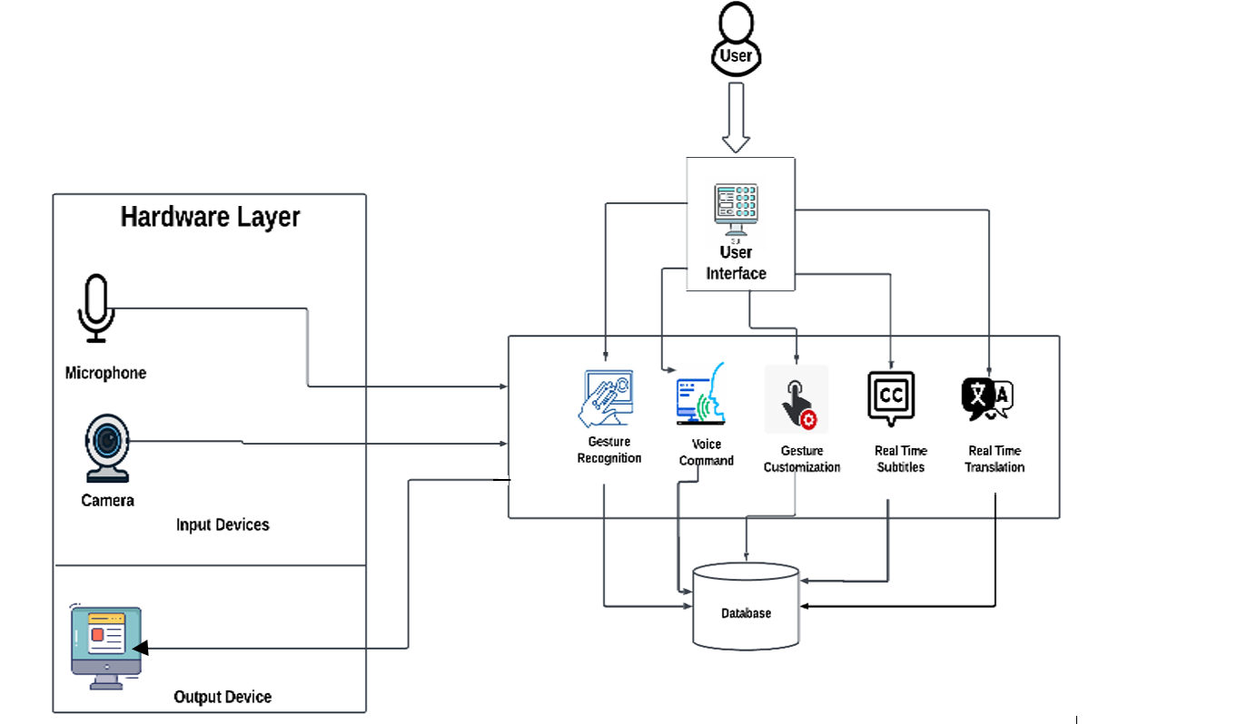
System Architecture
11th June 2025
13

Slide 14
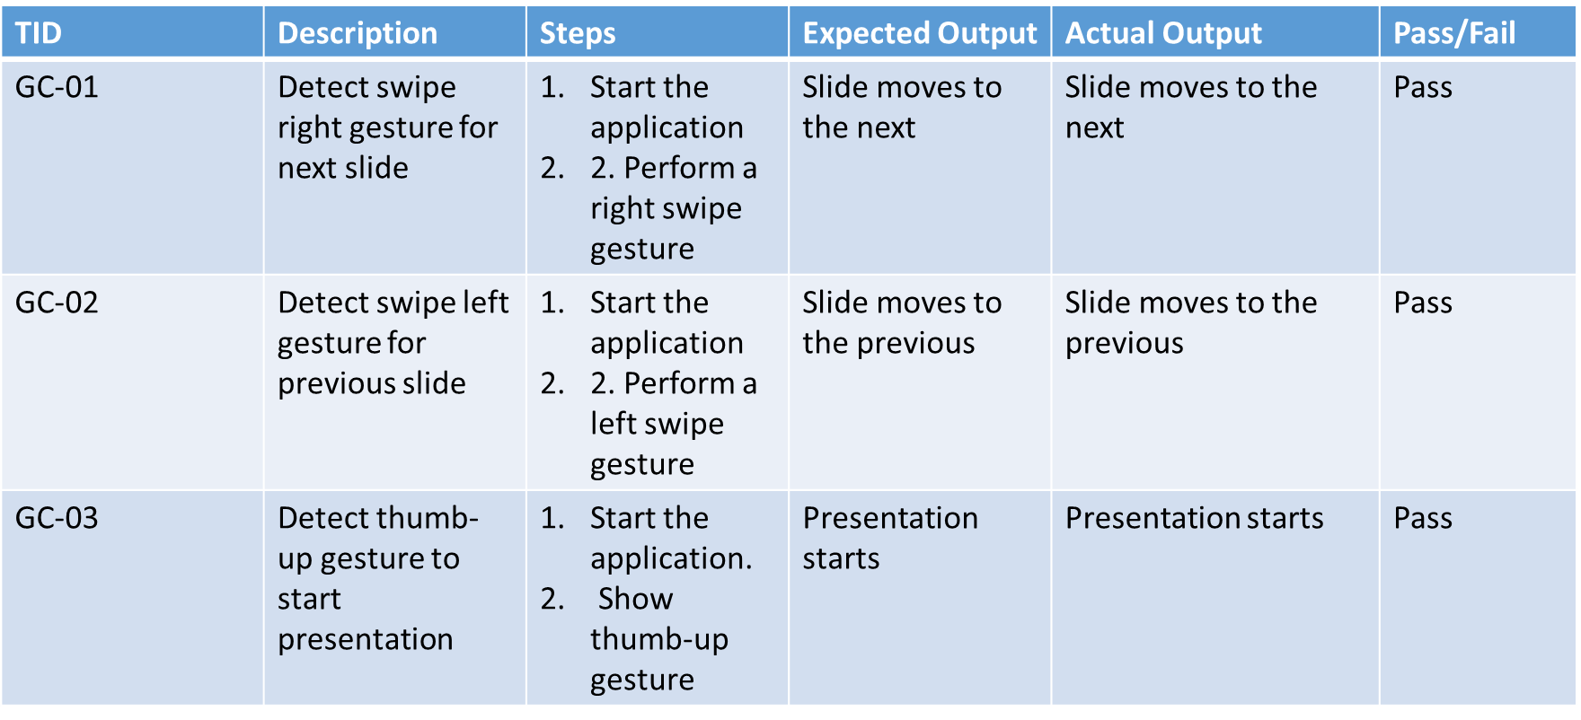
Test Cases : Gesture Control Module
11th June 2025
14

Slide 15
Test Cases : Gesture Control Module
TID | Description | Steps | Expected Output | Actual Output | Pass/Fail
GC-04 | Detect thumb-down gesture to end presentation | 1. Start the application. Show thumb-down gesture | Presentation ends | Presentation ends | Pass
GC-05 | Lock gestures using voice command | Start the application Say "Lock gestures" | Gestures are locked and status message displayed | Gestures are locked and status message displayed | Pass
11th June 2025
15

Slide 16
Test Cases : Gesture Control Module
TID | Description | Steps | Expected Output | Actual Output | Pass/Fail
GC-06 | Resume gestures using voice command | Start the application. Say "Resume gestures" | Gestures are unlocked and status message displayed | Gestures are still locked. | Fail
GC-07 | Ignore unrecognized gestures | 1. Start the application. Perform a random hand movement | No action is triggered | No action is triggered | Pass
GC-08 | Ignore unrecognized voice commands | Start the application Say an unrelated word(e.g., "Hello") | No action is triggered | No action is triggered | Pass
11th June 2025
16

Slide 17
Test Cases : Voice Control Module
TID | Description | Steps | Expected Output | Actual Output | Pass/Fail
VC-01 | Recognize 'next' command and navigate | 1. Start application 2. Say "Next slide" | Moves to next slide | Moves to next slide | Pass
VC-02 | Recognize 'previous' command and navigate | 1. Start application 2. Say "Previous slide" | Moves to previous slide | Moves to previous slide | Pass
VC-03 | Recognize 'go to slide [number]' command | 1. Start application 2. Say "Go to slide 5" | Navigates to slide 5 | Navigates to slide 5 | Pass
11th June 2025
17

Slide 18
Test Cases : Voice Control Module
TID | Description | Steps | Expected Output | Actual Output | Pass/Fail
VC-04 | Recognize 'start presentation' command | 1. Start application 2. Say "Start presentation" | Starts slideshow | Starts slideshow | Pass
VC-05 | Recognize 'stop presentation' command | 1. Start application 2. Say "Stop presentation" | Exits slideshow | Exits slideshow | Pass
VC-06 | Ignore unrecognized commands | 1. Start application 2. Say an unrelated word (e.g., "Hello") | No action triggered | No action triggered | Pass
11th June 2025
18

Slide 19
Test Cases : Voice Control Module
TID | Description | Steps | Expected Output | Actual Output | Pass/Fail
VC-07 | Handle incorrect slide number input | 1. Start application 2. Say "Go to slide 999" (invalid slide) | No navigation occurs | No navigation occurs | Pass
11th June 2025
19

Slide 20
Test Cases : Subtitle Module
TID | Description | Steps | Expected Output | Actual Output | Pass/Fail
RTS-01 | Recognize and display spoken words | 1. Start application 2. Speak clearly into the microphone | Spoken words appear as subtitles | Spoken words appear as subtitles | Pass
RTS-02 | Handle no speech input | 1. Start application 2. Stay silent for 10 seconds | Subtitle overlay remains empty | Subtitle overlay remains empty | Pass
11th June 2025
20

Slide 21
Test Cases : Subtitle Module
TID | Description | Steps | Expected Output | Actual Output | Pass/Fail
RTS-03 | Start subtitles overlay | 1. Start application 2. Call start_subtitle() function | Subtitle overlay appears on screen | Subtitle overlay appears on screen | Pass
RTS-04 | Stop subtitles overlay | 1. Start application 2. Call stop_subtitle() function | Subtitle overlay disappears | Subtitle overlay disappears | Pass
11th June 2025
21

Slide 22
Test Cases : Real time Translation Module
TID | Description | Steps | Expected Output | Actual Output | Pass/Fail
RTT-01 | Start real-time translation | 1. Start application 2. Call start_real_time_translation() function | Translation overlay appears on screen | Translation overlay appears on screen | Pass
RTT-02 | Stop translation overlay | 1. Start application 2. Call stop_real_time_translation() function | Translation overlay disappears | Translation overlay disappears | Pass
11th June 2025
22

Slide 23
Test Cases : Real time Translation Module
TID | Description | Steps | Expected Output | Actual Output | Pass/Fail
RTT-03 | Verify English to Hindi translation | 1. Start application 2. Select 'English to Hindi' option 3. Speak in English | Translated text appears in Hindi | Translated text appears in Hindi | Pass
RTT-04 | Verify Hindi to English translation | 1. Start application 2. Select 'Hindi to English' option 3. Speak in Hindi | Translated text appears in English | Subtitle overlay disappears | Pass
11th June 2025
23

Slide 24
Test Cases : Real time Translation Module
TID | Description | Steps | Expected Output | Actual Output | Pass/Fail
RTT-05 | Verify English to French translation | 1. Start application 2. Select 'English to French' option 3. Speak in English | Translated text appears in French | Translated text appears in French | Pass
RTT-06 | Verify English to German translation | 1. Start application 2. Select 'English to German' option 3. Speak in English | Translated text appears in German | Translated text appears in German | Pass
RTT-07 | Handle non-supported language input | 1. Start application 2. Speak in an unsupported language | Displays ‘Could not understand Audio’ | Displays ‘Could not understand Audio’ | Pass
11th June 2025
24

Slide 25
Test Cases : Gesture Customization Module
TID | Description | Steps | Expected Output | Actual Output | Pass/Fail
CG-01 | Store a new custom gesture in database | 1. Start application 2. Perform a new gesture 3. Assign an action and save | Gesture is saved in the database with angles and image | Translation overlay appears on screen | Pass
CG-02 | Retrieve stored gestures from database | 1. Start application 2. Navigate to gesture management 3. View stored gestures | List of stored gestures is displayed | List of stored gestures is displayed | Pass
11th June 2025
25

Slide 26
Test Cases : Gesture Customization Module
TID | Description | Steps | Expected Output | Actual Output | Pass/Fail
CG-03 | Detect a saved custom gesture and execute action | 1. Start application 2. Perform a stored custom gesture | Corresponding action (next slide) is triggered | Corresponding action (next slide) is triggered | Pass
CG-04 | Delete a stored custom gesture | 1. Start application 2. Navigate to gesture management 3. Delete a gesture | Gesture is removed from the database | Translation overlay appears on screen | Pass
11th June 2025
26

Slide 27
Test Cases : Gesture Customization Module
TID | Description | Steps | Expected Output | Actual Output | Pass/Fail
CG-05 | Update an existing gesture | 1. Start application 2. Navigate to gesture management 3. Select a gesture and update it | Gesture angles and image are updated | Gesture angles and image are updated | Pass
CG-06 | Handle duplicate gestures for different actions | 1. Start application 2. Try saving two different actions with similar gestures | The system detects duplicate gesture assignments and displays a warning. | Latest updated Gesture gets executed | Fail
11th June 2025
27

Slide 28
Test Cases : User Registration/Login
TID | Description | Steps | Expected Output | Actual Output | Pass/Fail
TT-01 | Successful Login | 1. Navigate to login page. 2. Enter valid username and password. 3. Click the login button. | Dashboard is displayed after successful login. | Dashboard displayed | Pass
TT-02 | Successful Registration | 1. Navigate to the registration page. 2. Fill in all required fields with valid data. 3. Click the register button. | A confirmation message is shown and the user is redirected dashboard | Successfully registered | Pass
11th June 2025
28

Slide 29
Test Cases : User Registration/Login
TID | Description | Steps | Expected Output | Actual Output | Pass/Fail
TT-03 | Unsuccessful Login with Invalid Credentials | 1. Navigate to login page. 2. Enter invalid username and/or password. 3. Click the login button. | Error message "Invalid credentials" is displayed | Error message "Invalid credentials" is displayed | Pass
TT-04 | Registration Failure for Existing User Account | 1. Navigate to the registration page. 2. Enter details for an already registered email/username. 3. Click the register button. | Error message "User already exists" is displayed, and the account is not created. | Error message displayed | Pass
11th June 2025
29

Slide 30
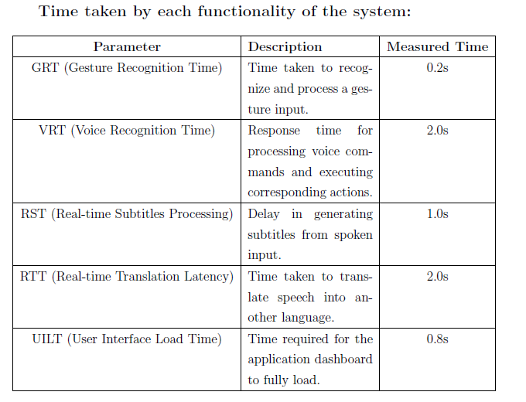
Results
11th June 2025
30

Slide 31
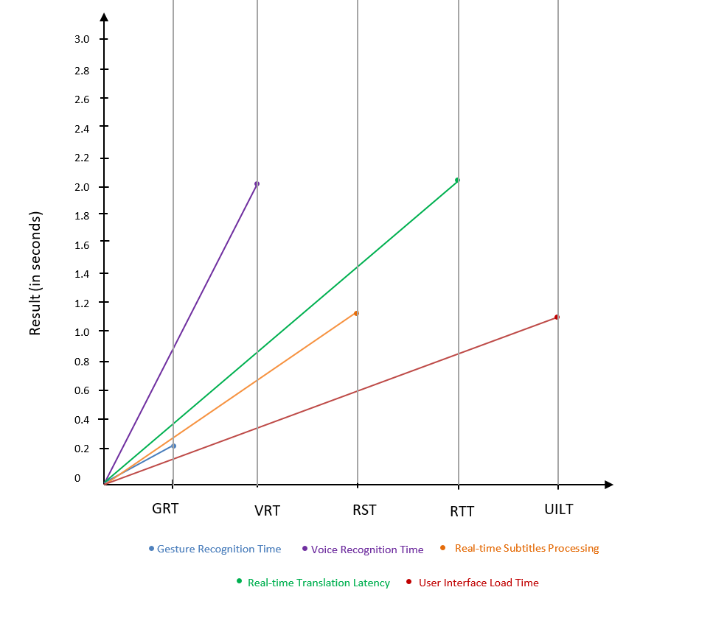
Results
11th June 2025
31

Slide 32
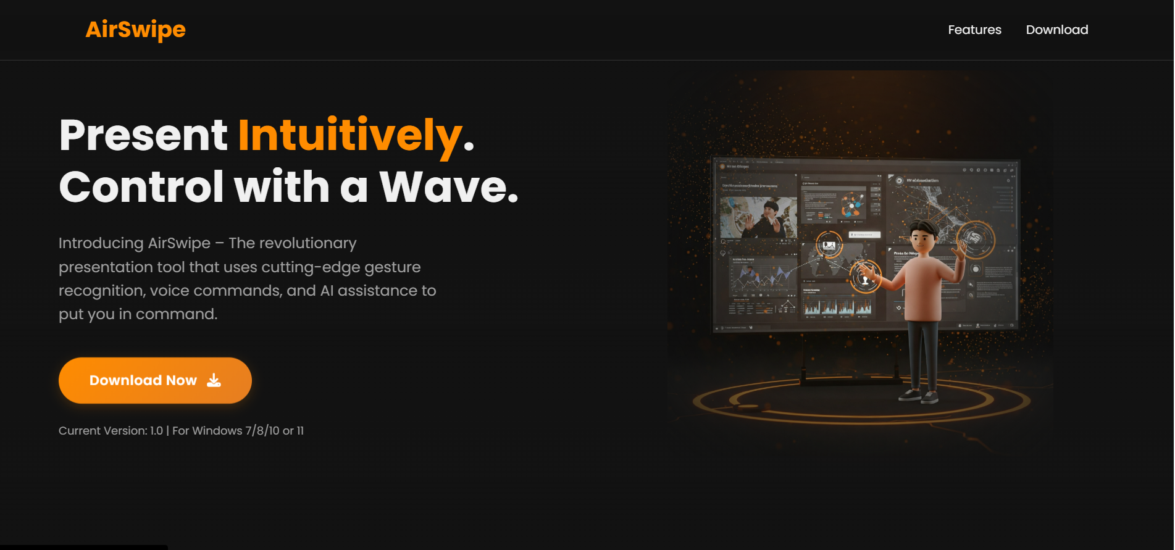
Deployment
https://airswipe.netlify.app/
11th June 2025
32

Slide 33
Conclusion
The proposed system aims to revolutionize the way users interact with presentation tools. By integrating gesture recognition and voice commands, users can control slides naturally and efficiently. Additionally, real-time subtitle generation and speech translation makes the system highly inclusive, allowing it to be used in educational seminars, business meetings, and multilingual conferences. Through this hands-free and AI-based interaction, the tool enhances accessibility, reduces dependency on hardware tools like remotes or clickers, and brings innovation to the presentation experience.
11th June 2025
33

Slide 34
References
[1] Y. Xu, M. Qin, C. Zhou, J. Peng, M. Batumalay, and C. K.Chan, “Research on Dynamic Gesture Recognition and Control System based on Machine Vision,” Journal of Electrical Systems, vol. 20, no. 2, pp. 616–628, Apr. 2024.
[2] A. Aldallal and Q. Abdali, “Smart Presentation Management Using Gesture Recognition and Machine Learning,” Journal of Electrical Systems, vol. 20, no. 10s, pp. 5516–5523, 2024.
[3] K. P. Kumari, B. B. Goud, K. Sumana, B. Naresh, and B. Harish, “Automated Gesture Controlled Presentation Using Machine Learning,” International Journal for Research in Applied Science and Engineering Technology (IJRASET), vol. 10, no. 11, pp. 1248–1251, Nov. 2022.
[4] S. Powar, S. Kadam, S. Malage, and P. Shingane, “Automated Digital Presentation Control using Hand Gesture Technique,” ITM Web of Conferences (ICACC 2022), vol. 44, art. 03031, May 2022. [5] R. M. Shakya, S. P. Sharma, and N. Shrestha, “The Use of Hand Gestures as a Tool for Presentation,” International Journal of Advanced Computer Science and Applications, vol. 14, no. 11, 2023.
11th June 2025
34

Slide 35
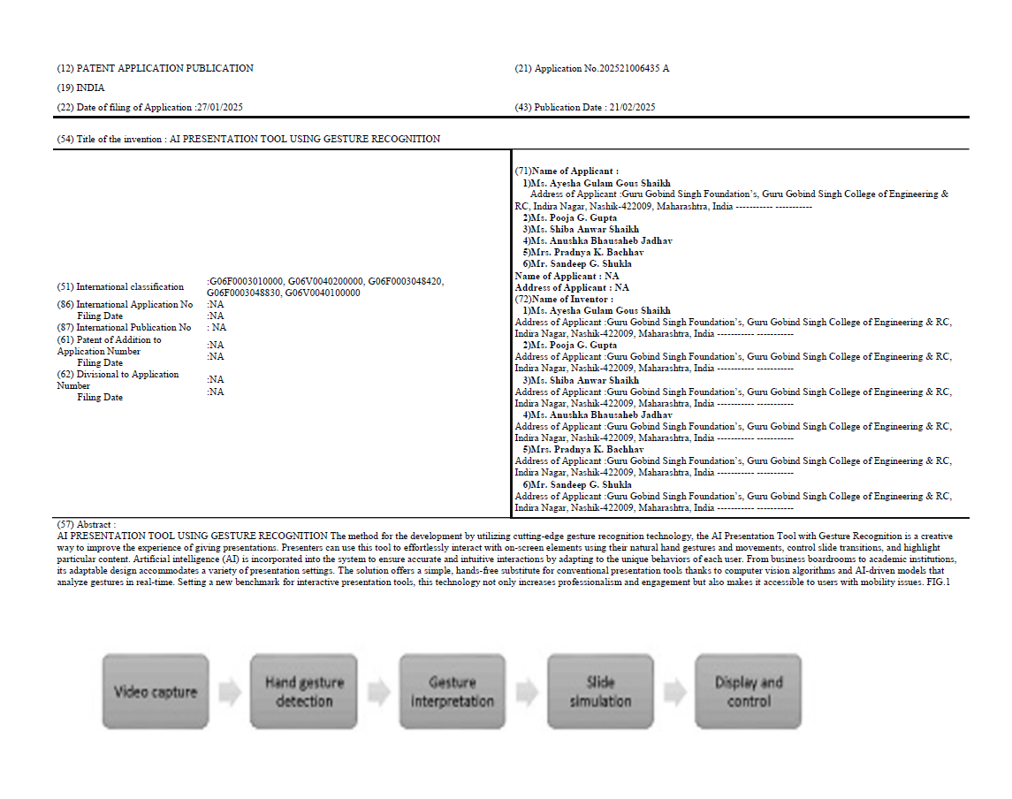
Patent Details
11th June 2025
35

Slide 36
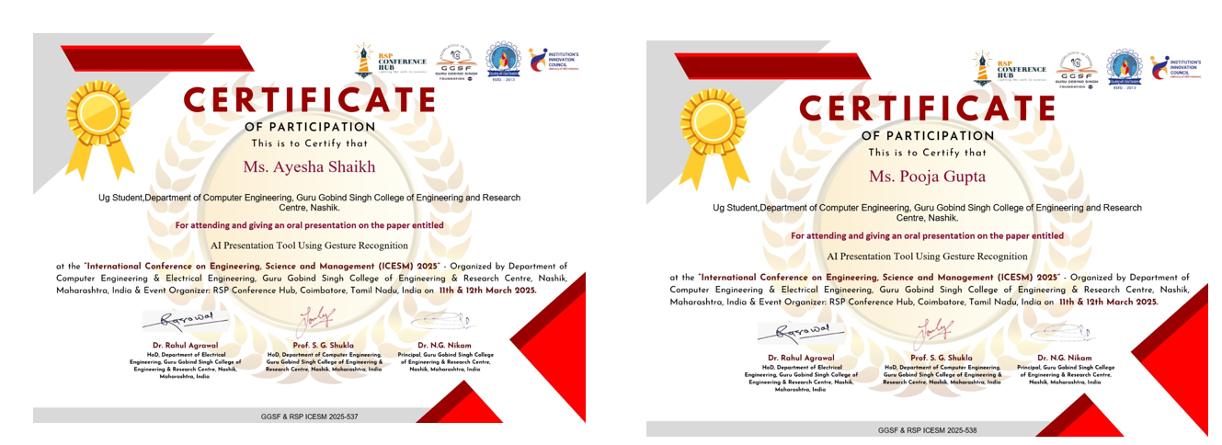
Conference Paper Presentation Details
We have participated in International Conference on Engineering Science and Management( ISCEM) 2025
11th June 2025
36

Slide 37
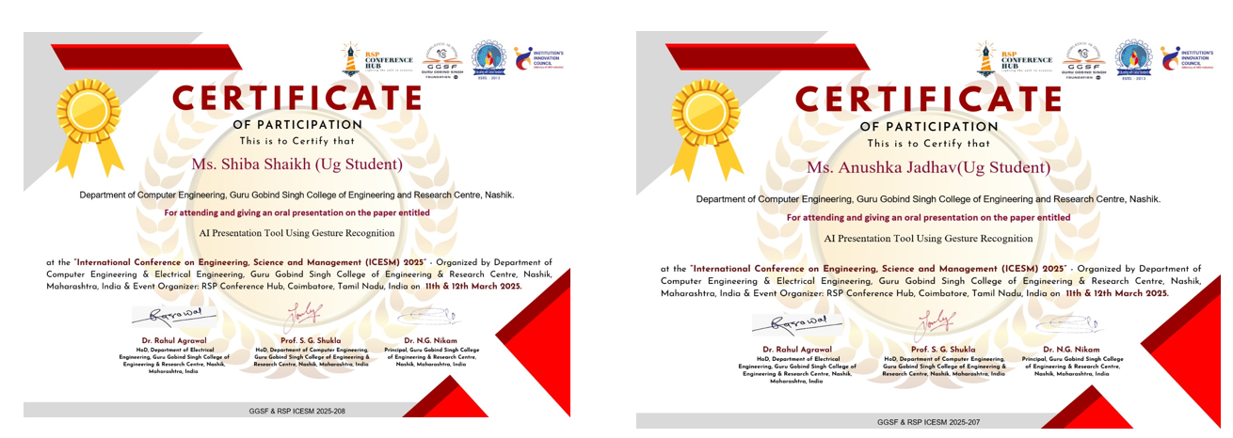
Conference Paper Presentation Details
We have participated in International Conference on Engineering Science and Management(ISCEM) 2025
11th June 2025
37

Slide 38
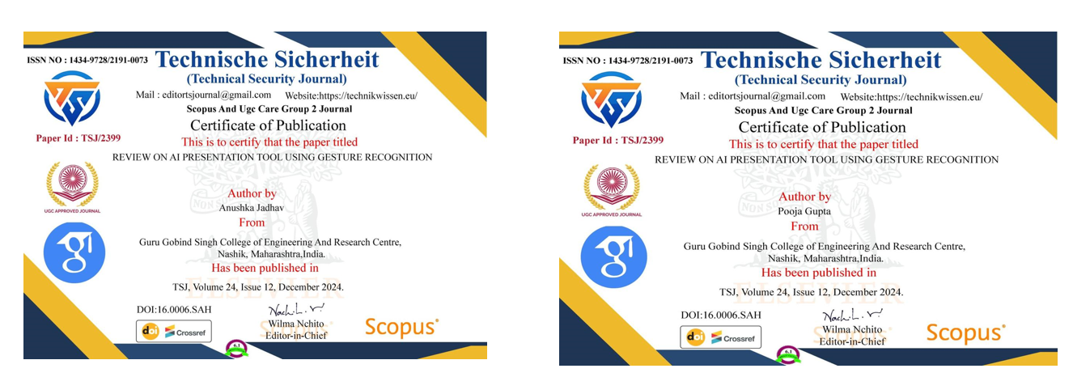
Paper Publication Details
We have Published paper in Technical Security Journal on ”Review on AI Presentation Tool Using Gesture Recognition” Paper ID: TSJ/2399, ISSN-1434-9728/2191-0073.
11th June 2025
38

Slide 39
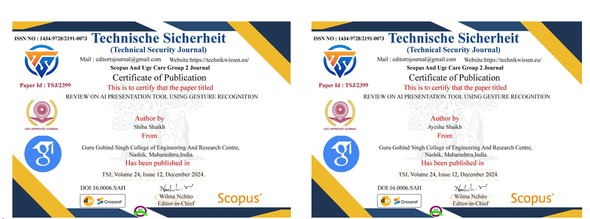
Paper Publication Details
We have Published paper in Technical Security Journal on ”Review on AI Presentation Tool Using Gesture Recognition” Paper ID: TSJ/2399, ISSN-1434-9728/2191-0073.
11th June 2025
39

Slide 40
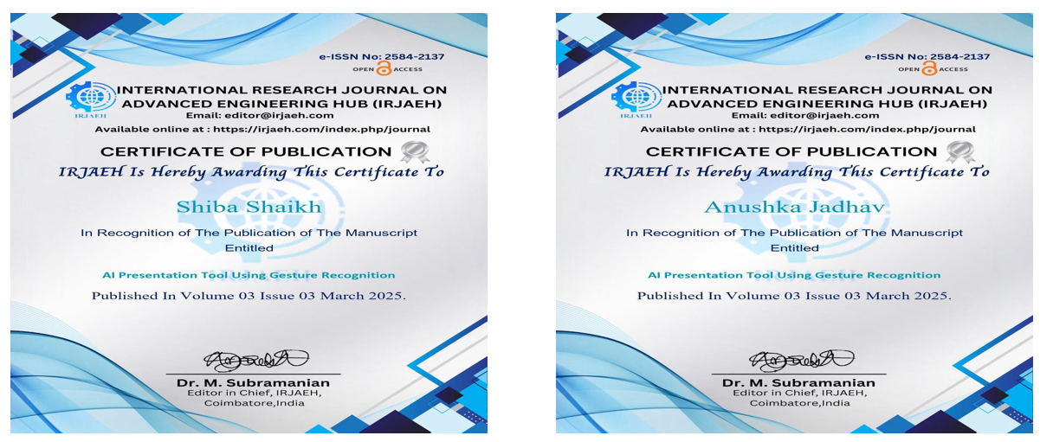
Paper Publication Details
We have Published paper in International Research Journal on Advanced Engineering Hub(IRJAEH) on ”AI Presentation Tool Using Gesture Recognition”, ISSN- 2584-2137.
11th June 2025
40

Slide 41
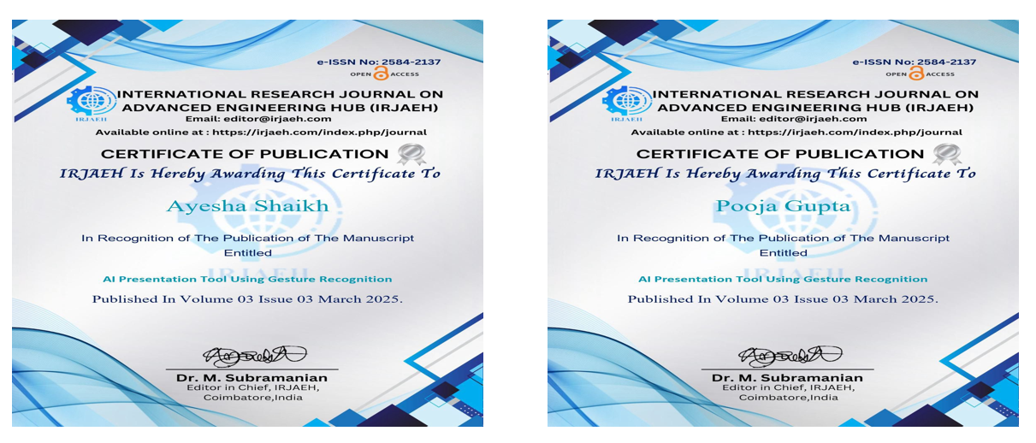
Paper Publication Details
We have Published paper in International Research Journal on Advanced Engineering Hub(IRJAEH) on ”AI Presentation Tool Using Gesture Recognition”, ISSN- 2584-2137.
11th June 2025
41

Slide 42
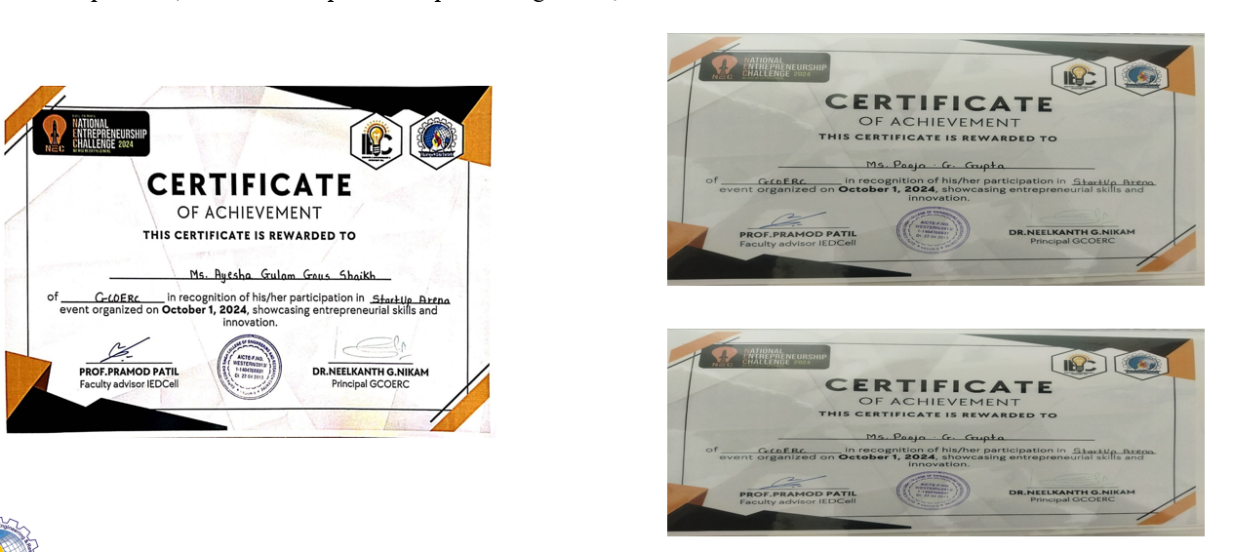
Project Competition Details
We have participated in Startup Arena(National Entrepreneurship Challenge 2024)
11th June 2025
42

Slide 43
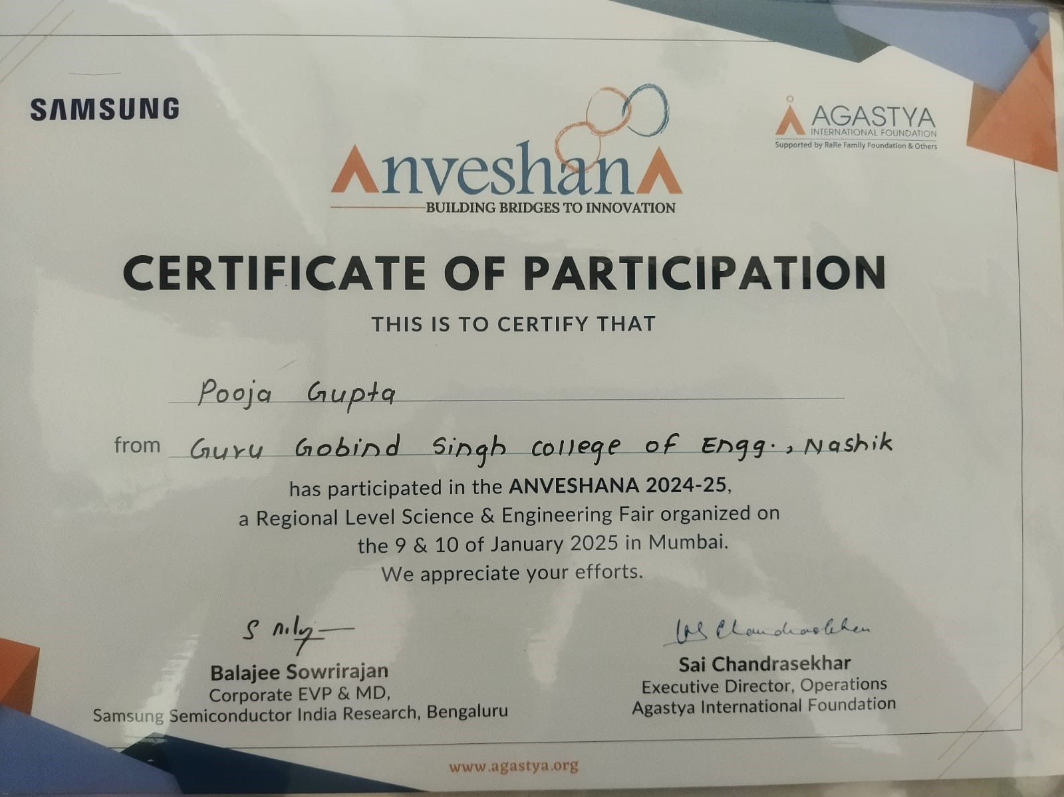
Project Competition Details
We have participated in ANVESHANA 2024-25 a Regional Level Science & Engineering Fair organized in Mumbai by AGASTYA INTERNATIONAL FOUNDATION.
11th June 2025
43

Slide 44
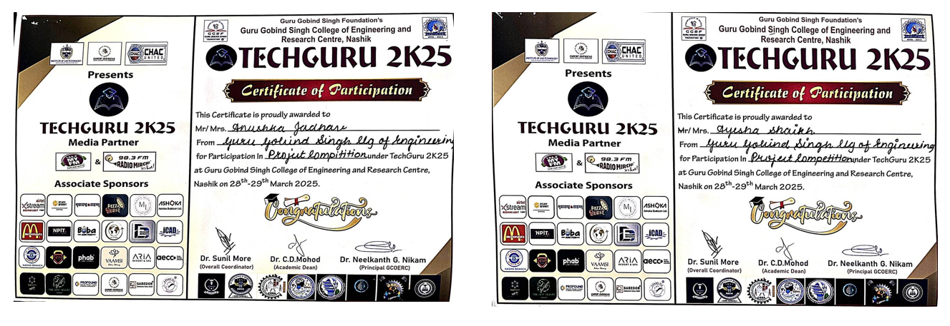
Project Competition Details
We have participated in TECH-GURU, 2K25 Organized by Guru Gobind Singh College of Engineering & Research Centre, Nashik.
11th June 2025
44

Slide 45
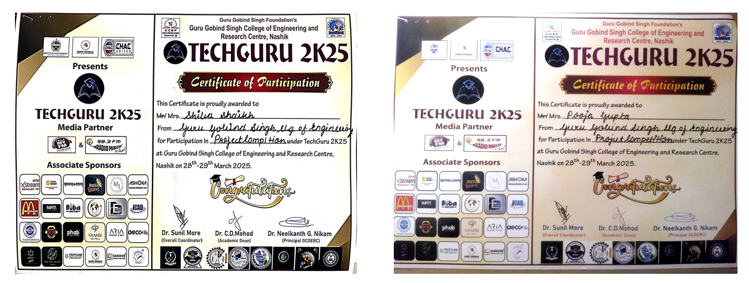
Project Competition Details
We have participated in TECH-GURU, 2K25 Organized by Guru Gobind Singh College of Engineering & Research Centre, Nashik.
11th June 2025
45

Slide 46
Demonstration
46

Slide 47
Question and Answer
47

Slide 48
Thank you !!!
48

